Slide 1
جامعة ديالى / كلية الهندسة
قسم الهندسة الإلكترونية
8085 Microprocessor
Lecture 5
المدرس إياد قيس عبد الكريم
2018

Slide 2
جامعة ديالى / كلية الهندسة
قسم الهندسة الإلكترونية
8085 Pin Diagram
The 8085A (commonly known as the 8085) is an 8-bit general purpose microprocessor capable of addressing 64K of memory. The device has forty pins, requires a +5 V single power supply, and can operate with a 3-MHz single-phased clock.
Figure 3 shows the logic pinout of the 8085 microprocessor. All the signals can be classified into six groups:
2018

Slide 3
جامعة ديالى / كلية الهندسة
قسم الهندسة الإلكترونية
8085 Pin Diagram
Address bus.
Data bus.
Control and status signals.
Power supply and frequency signals.
Externally initiated signal.
Serial I/O.
2018

Slide 4
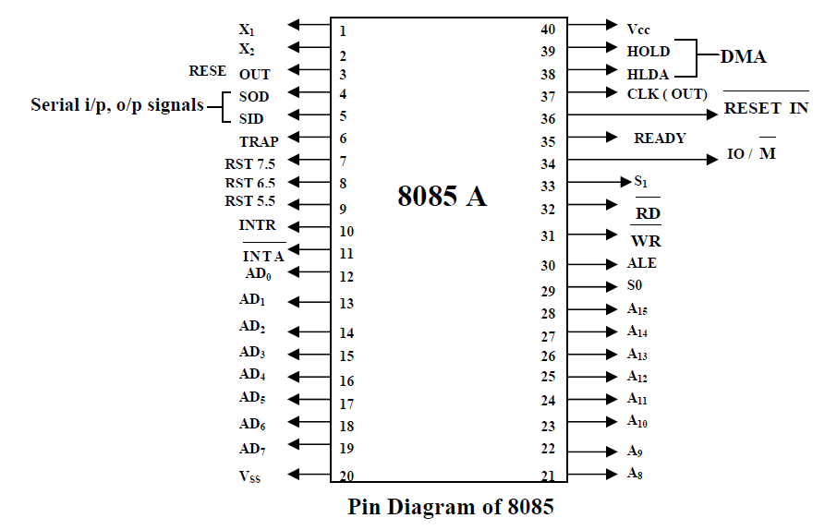
2018

Slide 5
جامعة ديالى / كلية الهندسة
قسم الهندسة الإلكترونية
8085 Pin Diagram
1. ADDRESS BUS
The 8085 has eight address lines A₁₅ – A₈, which are unidirectional and used as high order address bus.
2. MULTIPLEXED ADDRESS/DATA BUS
The signals lines AD7-AD0 are bidirectional; they serve dual purpose. They are used as the low order address bus as well as the data bus. In executing an instruction, during the earlier part of the cycle, these lines are used as the low-order address bus. During later part of die cycle, these lines are used as data bus. (This also known as multiplexing the bus.) However, the low-order address bus can be separated from these signals by using a latch.
2018

Slide 6
جامعة ديالى / كلية الهندسة
قسم الهندسة الإلكترونية
8085 Pin Diagram
3. CONTROL AND STATUS SIGNALS
This group of signals includes two control signals (RD and WR), three status signals IO/M, S_{i}, and S_{o}) to identity the nature of the operation, and one special signal (ALE) to indicate the beginning of the operation. These signals are as follows:
4. ALE:
Address Latch Enable: This is a positive going pulse generated every time the 8085 begins an operation (machine cycle); it indicates that the bits on AD₇-AD₀ are address bits. This signal is used primarily to latch the low-order address from the multiplexed bus and generate a separate set of eight address lines, A₇-A₀.
2018

Slide 7
جامعة ديالى / كلية الهندسة
قسم الهندسة الإلكترونية
8085 Pin Diagram
5. RD—Read: This is a Read control signal (active low). This signal indicates that the selected I/O or memory device is to be read and data are available on the data bus.
6. WR—Write: This is a Write control signal (active low). This signal indicates that the data on the data bus are to be written into a selected memory or I/O location.
2018

Slide 8
جامعة ديالى / كلية الهندسة
قسم الهندسة الإلكترونية
8085 Pin Diagram
7. IO/M: This status signal used to differentiate between I/O and memory operations. When it is high, it indicates an I/O operation; when it is low, it indicates a memory operation. This signal is combined with RD (Read) and WR (Write) to generate I/O and memory control signals. .
8. S₀ and S₁: These status signals, similar to IO/M, can identify various operations but they are rarely used in small systems. All the operations and their associated status signals are listed in Table 3.1 for reference.
2018

Slide 9
جامعة ديالى / كلية الهندسة
قسم الهندسة الإلكترونية
8085 Pin Diagram
POWER SUPPLY AND CLOCK FREQUENCY
The power supply and frequency signals are as follows:
Vcc: +5 V power supply.
Vss: Ground Reference.
X₁, X₂: A crystal (or RC, LC network) is connected at these two pins. The frequency is internally divided by two: therefore, to operate a system at 3 MHz, the crystal, should have a frequency of 6 MH_{z}.
CLK (OUT) Clock Output: This signal can be used as the system clock for other devices.
2018

Slide 10
جامعة ديالى / كلية الهندسة
قسم الهندسة الإلكترونية
Externally initiated signals, including interrupts
The 8085 has five interrupt signals that can be used to interrupt a program execution. One of the signals. INTR (Interrupt Request), is identical to the 8080A micro­processor interrupt signal (INT); the others are enhancements to the 8080A. The micro­processor acknowledges an interrupt request by the INTA (Interrupt Acknowledge) signal.
In addition to the interrupts, three pins—RESET. HOLD, and READY—accept the externally initiated signals as inputs. To respond to the HOLD request, it has one signal called HLDA (Hold Acknowledge).
RESET IN: When the signal on this pin goes low, the program counter is set to zero, the buses are tri-stated, and the MPU is reset.
RESET OUT: This signal indicates that the MPU is being reset. The signal can be used to reset other devices.
SERIAL I/O PORTS
The 8085 has two signals to implement the serial transmission: SID (Serial Input Data) and SOD (Serial Output Data).
2018

Slide 11
شكراً لإصغائكم ...
أسئلة ؟
2018

